Slide 1


Slide 2
AGENDA →
My Introduction
What is Agentic AI
ML vs AI vs Generative AI vs Agentic AI
Agentic AI framework
Agentic AI Projects
New Batch Announcement
Generative AI Workshop Videos
Question & Answer

Slide 3
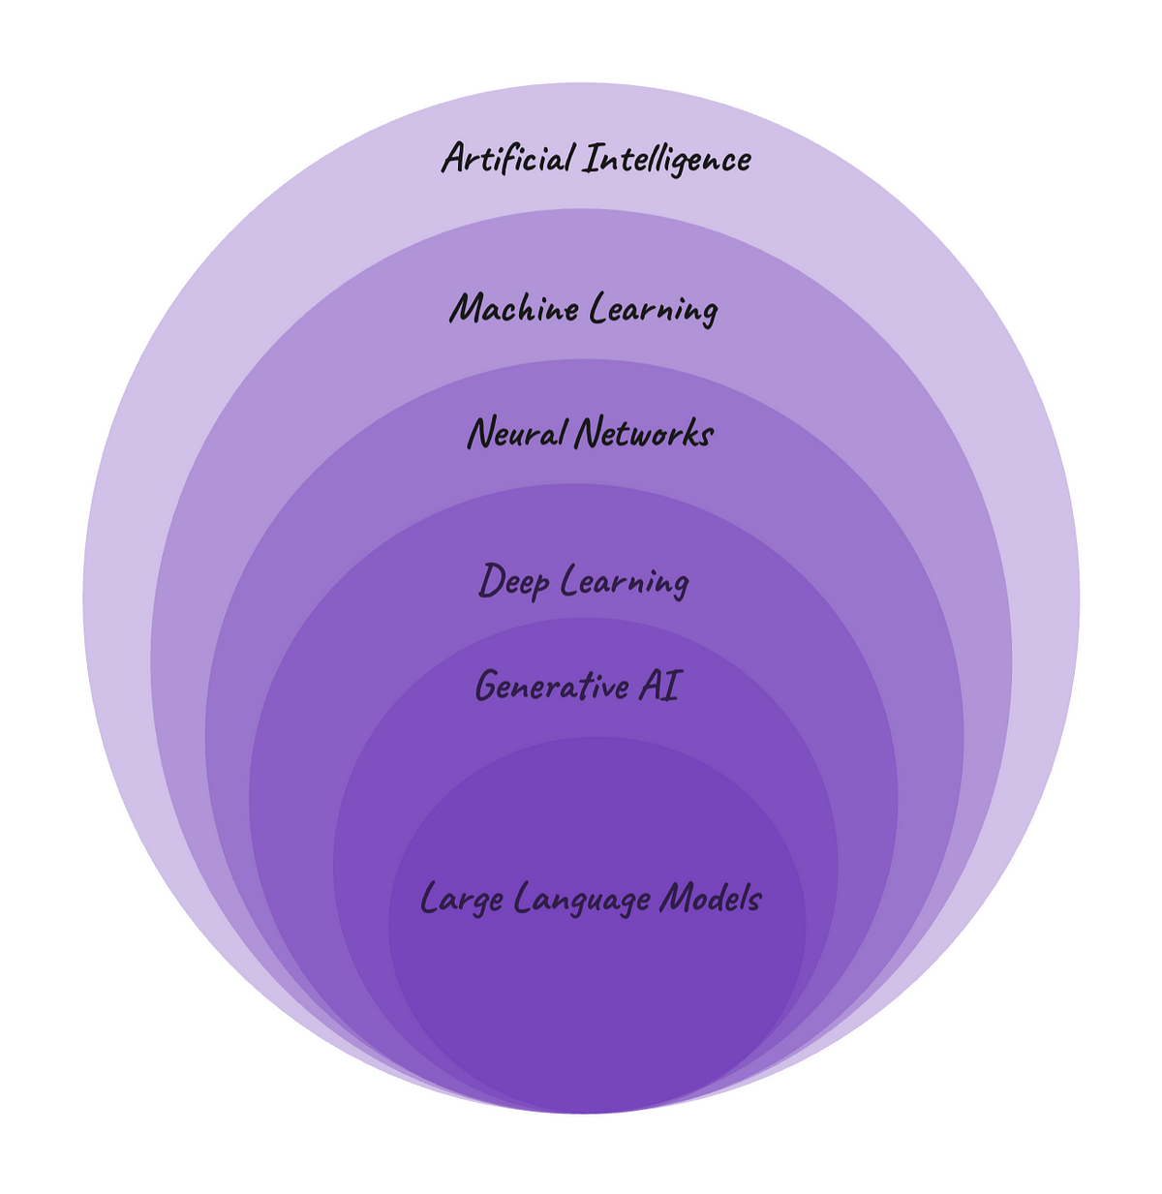
DATA SCIENCE
SUPERVISED LEARNING
UNSUPERVISED LEARNING
REINFORCEMENT LEARNING
MACHINE LEARNING
ARTIFICIAL ITELLIGENCE
GENERATIVE
Artificial Intelligence
NLP
LLM MODELS
REGRESSION
CLASSIFICATION
DEEP LEARNING
NEURAL NETWORK
OPEN AI
CLUSTERING
CREW AI
GOOGLE
AGENTIC
AI
Auto Gen
META
CLAUDE
Phi data

Slide 4
What is Agentic AI
Agentic AI is a type of artificial intelligence (AI) that can make decisions and take actions independently or Automatically.
These agents operates autonomously with a sense of agency based on goals & environmental feedback without human supervision.

Slide 5
Examples of Agentic AI
Autonomous Vehicles: AI systems that perceive surroundings, make driving decisions, and learn from each trip.
Supply Chain Management: AI optimizes inventory, predicts demand, and adjusts delivery routes.
Cybersecurity: AI detects threats by analyzing network activity.
Healthcare: AI analyzes patient data, considers historical trends, and suggests personalized treatment plans.
HR Operations: AI automates resume screening, interview scheduling, and payroll management.
Business Processes: AI handles reordering supplies and optimizing operations.

Slide 6
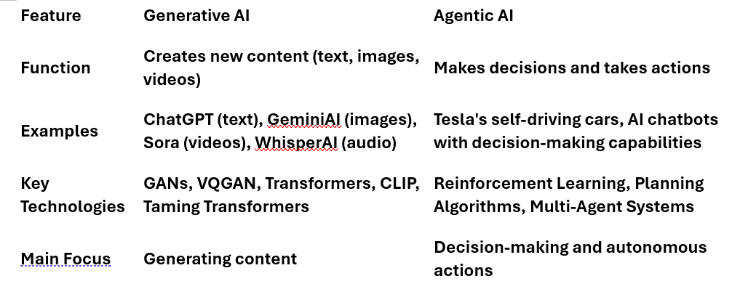
Generative AI vs Agentic AI

Slide 7


Skills Needed to Become an Agentic AI Developer
Python Programming & Data Analysis
AI and Machine Learning Fundamentals
Generative AI, LLM Models
Prompt Engineering
Transformer Learning, Architecture
Cloud and Edge Computing
Ethics and Responsible AI

Slide 8
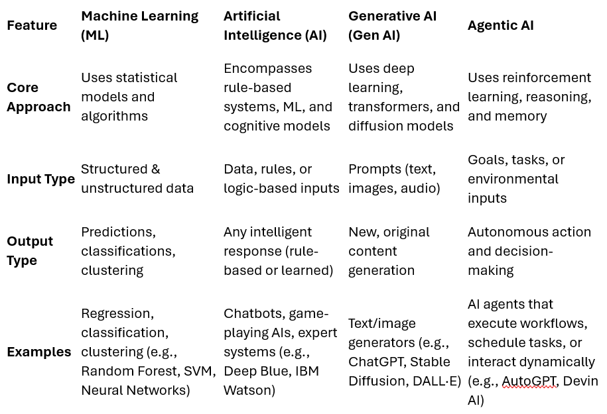
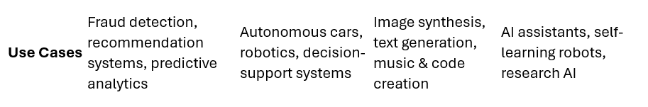

Slide 9

ML vs AI vs Generative AI vs Agentic AI
ML is about learning from historical data where user need to train the data.
AI is the broader field where we used ML, DL, NLP Algorithm to build AI application (Birthday Recommendation or Movie Recommendation & Review Analysis)
Gen AI is a subset of AI focused on creating new content without trained by user. LLM Models pre-trained by OpenAI, DeepSeek, google, meta, claude
Agentic AI takes AI a step further by enabling decision-making and task execution autonomously.

Slide 10

AGETIC AI PROJECT
IDE → VS code
Agentic AI Framework → Phi Data
Search Engine → Duck-Duck Go Search
LLM Model → Meta’s (llama-3.3-70b-versatile) & OpenAI (Gpt- 4o)
Interface → Groq LPU
Frontend → Streamlit
====
Project:1 →Test the Phi Data Agents
Project:2 → Build stock agents
Project:3 → Build Cricket Multi agent using open-AI ( Paid Open AI key required) Multi Agents can Build by opensource (Open Source Llama model)

Slide 11
Popular Agentic AI Frameworks to Learn
LangChain & LangGraph
Phidata
CrewAI
AutoGen

Slide 12
Previous workshop videos
ChatGPT → https://www.youtube.com/watch?v=SDStCnlITT8
Generative AI Workshop → https://www.youtube.com/watch?v=Xp1MnygECUs
LARGE LANGUAGE MODEL → https://www.youtube.com/watch?v=v0w9LXXrsys
Gen AI with Langchain, OpenAI & LLMops → https://www.youtube.com/watch?v=MAkXifYHnuw&t=1320s
Google Generative AI | Gemini AI→ https://www.youtube.com/watch?v=BDrXdvNh19Q&t=5684s
LLM Model Using Lama 3,Hugging Face & Ollama → https://www.youtube.com/watch?v=eDN6fAWLNNE&t=5425s
GEMMA-9B Integration with GROQ, HUGGINGFACE → youtube.com/watch?v=Bp1XyvMvedg&t=7086s
NLP→ https://www.youtube.com/watch?v=s-xhKH-e8ig&t=5844s
RAG→ https://www.youtube.com/watch?v=8nWjvn8ZKtU&t=7553s
AGENTIC AI_PART-1 || CREW AI→ https://www.youtube.com/watch?v=0gqlrw-6I0s
STABLE DIFFUSION → https://www.youtube.com/watch?v=LR2r3QR_SD8&t=8273s
prompt engineer(part-1) → https://www.youtube.com/watch?v=2n-RIgSNnwQ&t=8628s
prompt engineer(part-2) → https://www.youtube.com/watch?v=HvqtHmeblvQ&list=PLVlQHNRLflP81c99eg7UhkVZxwPvhTddM&index=39
Deepseek → https://www.youtube.com/watch?v=ai-v9KNUZ1Q&t=6088s
AGENTIC AI → https://www.youtube.com/watch?v=cFYyQn5Mohc

Slide 13
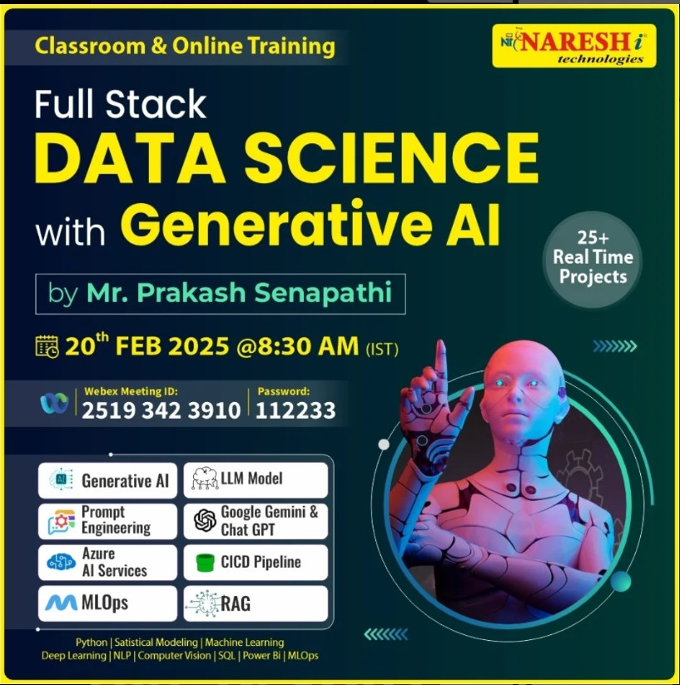
New Batch Announcement
^^^^^^ 👉 Backup Video:
Day-1: youtube.com/watch?v=fI13-OYNmcw
Day-2: https://youtu.be/gStlVJp8T4Q
📂 Drive Link: https://t.ly/Q2mLC
^^^^^^^^^^^^^^
📂 Google Drive Link: https://t.ly/usQgG👨
💻 Software Installation: https://t.ly/YoRAA
💻 python identifier →
youtube.com/watch?v=7HEke2aEND0
^^^^^^^^^^^^^^^^

Slide 14
